Slide 1



HappyPaws
Final Year B.Tech Project
2025
HAPPYPAWS
SPRING PETCLINIC APPLICATION
Presented By:
Abhishek Kumar (Team Leader)
B Girinath Reddy
Chapala Praveen
Gudipati Jayasimha Vardhan
M Subham
Department of Computer Science & Machine Learning (CSM),
SVCET, Chittoor

Slide 2
01
PROJECT OVERVIEW
2025
What is HappyPaws?
A full-stack veterinary clinic management system.
Built on the modern Spring PetClinic architecture.
Core Purpose:
Manages clinic operations: Owners, Pets, Visits, and Veterinarians.
Provides a centralized, structured platform for veterinary services.
Key Differentiator:
Replaces the traditional monolithic Spring PetClinic with a modern decoupled architecture (React Frontend + Spring Boot Backend).
Final Year B.Tech Project
HappyPaws

Slide 3
02
Studio Shodwe
Project.
2025
MOTIVATION
01
The Problems:
02
The Solution:
Traditional academic projects often focus solely on backend logic.
Legacy systems lack modern, interactive user interfaces.
Enterprise-Level Practices: Demonstrates layered architecture and RESTful APIs.
Production-Ready Approach: Bridges the gap between academic theory and industry standards.

Slide 4

HappyPaws
Final Year B.Tech Project
2025
OBJECTIVES
Develop a full-stack web application using React and Spring Boot.
Implement robust CRUD operations on real-world entities (Pets, Owners).
Adhere to strict Layered Architecture principles.
Build secure RESTful APIs with proper database persistence.
Create a clean, maintainable reference project for future students.
03

Slide 5
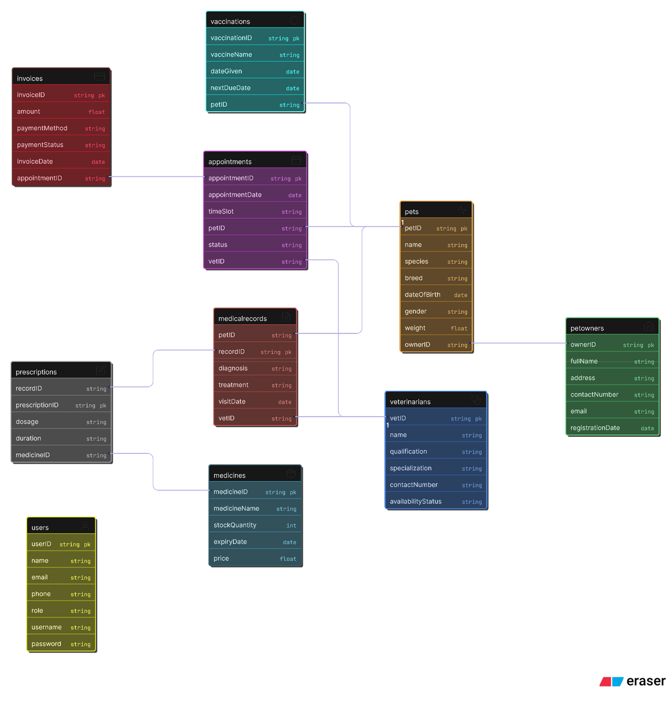
04
SYSTEM ARCHITECTURE
Project.
HappyPaws

Slide 6
TECHNOLOGY STACK
FRONTEND:
React.js v18.2.0
HTML5, CSS3, JavaScript (ES6+)
BACKEND:
Java v17
Spring Boot v3.9.5
Spring MVC, Spring Data JPA
DATABASE:
MySQL v8.0.x
TOOLS:
VS Code, Maven, Git/GitHub,
Postman
HappyPaws
Final Year B.Tech Project
05

Slide 7
06
OWNER MODULE:
VETERINARIAN MODULE:
Register and manage pet owners.
Manage vet profiles and specialties.
KEY
MODULES
PET MODULE:
Add and update pet details/medical history.
AUTH MODULE:
MAPPING OUR THOUGHTS
Secure login and role management.
VISIT MODULE:
Schedule and track clinic visits.
HappyPaws
Final Year B.Tech Project
2025

Slide 8
KEY FEATURES
2025
User Authentication & Authorization: Secure access.
Role-Based Access Control (RBAC): Distinct permissions for Admins vs. Users.
RESTful API Communication: Seamless data flow between React and Spring Boot.
Layered Architecture: Modular, scalable, and easy to maintain.
Project.
07
HappyPaws

Slide 9
08
HappyPaws
Final Year B.Tech Project
2025
LIMITATIONS :
Designed primarily for single-clinic usage (not multi-tenant).
Uses basic security mechanisms (opportunity for upgrade).
Lacks real-time notifications (SMS/Email).
Not currently optimized for high-traffic, large-scale deployment.
LIMITATIONS &
FUTURE ENHANCEMENT
FUTURE ENHANCEMENTS :
Security : Implementation of JWT (JSON Web Tokens).
Cloud : Deployment on AWS or Google Cloud Platform (GCP).
Mobile : Development of a companion mobile app (React Native/Flutter).
AI Integration : AI-based pet health analysis and recommendations.
Microservices : Migration from monolithic to microservices architecture.

Slide 10
HappyPaws
Final Year B.Tech Project
2025
Impact:
Effective tool for managing veterinary operations.
Serves as a bridge between academic learning and professional software engineering
09
CONCLUSION
SUMMARY:
HappyPaws successfully integrates React and Spring Boot.
Demonstrates mastery of modern full-stack development.

Slide 11
THANK YOU
REFERENCES
Dr. Pet Online : https://drpetonline.in/
Supertails Clinic : https://supertails.com/
Zigly Pet Care : https://stores.zigly.com/

